Slide 1

IS Operations & Business Resilience II
Information Systems Auditing
Class X

Slide 2
Class Recap

Slide 3
Class Roadmap
IT Governance: Concept
IT Governance: Audit Program
IS Acquisition and Development
IS Implementation
Practicum on Domain 3
Navigating International Standards (GTAG)
Mid-Term Exam Prep
Mid-Term Exam
IS Operation & Business Resilience I
IS Operation & Business Resilience II
Protection of Information Assets I
Protection of Information Assets II
Intro to SQL for Auditing
Case Study: Auditing with SQL
Final Exam Prep
Final Exam

Slide 4
Covered So Far
Domain I: The general process of Auditing
Domain II: IT Governance + COBIT 2019
Domain III: IS Acquisition, Development, and Implementation
Domain IV part I: IS Operations

Slide 5
Intro: Why This Topic Matters
Business Impact Analysis
Business Continuity Plan & Disaster Recovery Plan
System Resilience Strategies
Backup, Restoration, and Replication

Slide 6
Intro
#operations #continuity #resilience

Slide 7
Abnormal Conditions → “Emergency Mode”
How the organization survives disruptions:
Disaster recovery
Backup & restore
Continuity planning
Crisis management
Analogy:
the “emergency plan” when the kitchen catches fire but the restaurant still needs to serve customers.

Slide 8
Auditor’s Concern
IS auditors must know:
which controls should exist in operations
how incidents and changes should be managed
what backup and restore evidence looks like
how to assess BCP/DRP completeness
whether recovery strategies meet business needs

Slide 9
Why Matters?

Slide 10
Why Business Resilience Matters
Organizations rely heavily on technology → downtime = financial loss, compliance risk, reputation damage
Threats increasing: cyberattacks, system failures, human errors, natural disasters
IS auditors ensure plans exist, controls work, and management can recover
Aligns with CISA domains on availability, continuity, and risk mitigation

Slide 11
Business Continuity (BC)
Focus: Maintaining critical business functions during a disruption.
Key Questions:
What processes must continue at all costs?
How quickly must they recover?
What resources do they rely on?
Analogy:
If your house loses electricity, BC is your generator keeping the essentials alive.

Slide 12
IT Service Continuity (ITSC)
Focus: Ensure IT services remain available or restored within acceptable time.
CISA Emphasis:
Integration with business priorities
Alignment with service-level agreements (SLA)
IT capabilities must match business recovery requirements
Analogy:
Like ensuring your phone network stays up even when one tower goes down — rerouting keeps service alive.

Slide 13
Disaster Recovery (DR)
Focus: Recovering IT systems, data, and infrastructure after a major incident.
Includes:
Backup strategy
Alternate processing sites
Restoration procedures
Failover and failback operations
Analogy:
If BC is the generator, DR is the electrician fixing the entire power system.

Slide 14
Business Continuity Management
Business Impact Analysis (BIA)
Recovery Objectives
Business Continuity Plan (BCP)
Test and Maintain Plans
Disaster Recovery Plan (DRP)

Slide 15
Business Impact Analysis

Slide 16
Business Impact Analysis (BIA)
BIA identifies:
Critical processes
Dependencies (people, tech, data, vendors)
Impact of downtime (financial, operational, reputational)
Recovery requirements (RTO, RPO, etc.)
Which process is important?
What resources do those processes rely on?
How bad is it to have that process down?
How do we tolerate the system before being recovered?

Slide 17
Terms Used to Tolerate Downtime
These four terms come from Business Impact Analysis (BIA) and help determine how quickly an organization must recover from a disruption.
Term | Definition | Analogy
Recovery Time Objective (RTO) | The maximum acceptable time a system or process can be down before it seriously harms the business. | If your phone breaks during the day, RTO is the maximum time you can survive without your phone before work/life becomes unmanageable.
Recovery Point Objective (RPO) | The maximum acceptable amount of data loss, measured in time. | If your phone fails, RPO is how far back the last backup is—1 day? 1 hour? 10 seconds?
Work Recovery Time (WRT) | The time needed after systems are back online to validate, restore, reconfigure, and resume normal business operations. | Your phone turns back on after repair (RTO achieved), but you still need time to reinstall apps, log in, restore contacts, and set it up. That setup time = WRT.
Maximum Tolerable Downtime (MTD) | The total maximum time the business process can be unavailable before the consequences become unacceptable (financial, regulatory, safety, etc.) | You can live without your phone for a total of 8 hours before it truly disrupts your life. That 8 hours = MTD.

Slide 18
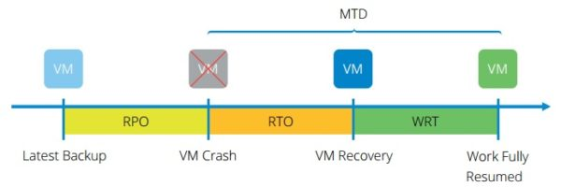
RTO, RPO, WRT, MTD - Ilustration
Imagine a system goes down at 09:00 AM.
Concept | Meaning | Example
RPO | How much data loss is acceptable? | RPO = 2 hours → data up to 07:00 must be safe
RTO | How fast IT must restore the system | RTO = 4 hours → system must be up by 13:00
WRT | Time for business to resume fully after IT recovery | WRT = 2 hours → ready by 15:00
MTD | Total downtime allowed | MTD = 6 hours

Slide 19
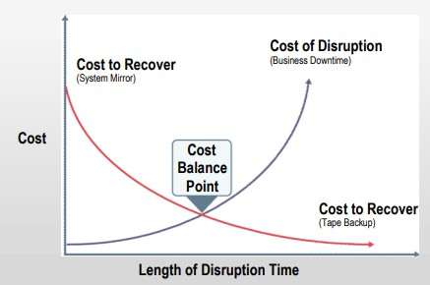
Inherent Trade-off

Slide 20
BCP & DRP

Slide 21
The Difference
Aspect | BCP | DRP
Scope | Whole organization | IT systems & infrastructure
Focus | Business processes & people | Technology recovery
Purpose | Continue business functions | Restore IT capacity
Relationship | The BCP is the overarching strategic plan | The DRP is a tactical, technical sub-component of the BCP

Slide 22
Types of BCP/DRP Tests
Test Type | Brief Explanation | Example
Checklist Review | Reviewing the plan on paper to confirm accuracy of contacts, procedures, and resources. | Team checks whether the phone list, vendor info, and backup inventory are up to date.
Tabletop Exercise | Key personnel discuss what they would do in a hypothetical incident. No technical action. | Managers walk through how they would respond to a cyberattack scenario.
Simulation Test | Staff practice recovery steps in a simulated or test environment without affecting production. | IT simulates a server crash and restores it in a test lab.
Parallel Test | DR systems are activated and run side-by-side with production to confirm they work. | The DR database is restored and run parallel to the live DB to compare results.
Full Interruption Test | Production is shut down and operations fully move to the recovery site. | The organization powers down the primary data center and operates completely from the DR site.

Slide 23
Maintaining the Plan
Update after system changes
Include contact lists, vendor info, network diagrams
Review test results → lessons learned
Ensure business and IT alignment
Involve senior management & key stakeholders

Slide 24
System Resilience General Strategies

Slide 25
Preventive Strategies
Preventive Strategy | Brief Explanation | Example
Redundant Systems | Duplicate critical components so if one fails, another takes over. | Using two database servers in a cluster so service continues if one crashes.
UPS and Generators | Provide backup power to keep systems running during power outages. | A data center switches to UPS instantly, then to generators within minutes.
Network Failover | Automatic switch to an alternate network path or ISP when primary link fails. | Internet traffic reroutes to a backup link when the main ISP goes down.
Hardening Infrastructure | Strengthening systems to reduce vulnerabilities or failures. | Disabling unused ports/services, applying secure configs, enforcing strong access controls.
Patch Management | Regularly updating systems to fix known security and stability issues. | Applying OS and application patches monthly to prevent exploits or software crashes.

Slide 26
Detective Strategies
Detective Strategy | Brief Explanation | Example
Monitoring Tools | Systems that continuously watch performance, availability, and health of IT components. | A monitoring dashboard alerts when CPU usage spikes or a server stops responding.
Intrusion Detection | Tools that detect suspicious or malicious activity in networks or systems. | IDS detects unusual traffic patterns indicating a potential attack.
Log Analysis | Reviewing system, application, or security logs to spot anomalies or issues. | Automated log analyzer flags repeated failed login attempts.
Alerting Mechanisms | Notifications triggered when predefined thresholds or events occur. | SMS/email alerts sent to admins when the database server goes down.

Slide 27
Corrective / Recovery Strategies
Enable recovery after incident:
Backups (full, incremental, differential)
Replication (synchronous, asynchronous)
Alternate sites (hot, warm, cold)
Cloud disaster recovery
Manual workarounds

Slide 28
Backup, Restoration, and Replication

Slide 29
Backup Strategies
Backup Type | What It Does | Advantages | Limitations | Simple Example
Full Backup | Copies all data every time. | Easiest to restore; complete copy. | Slow; uses most storage. | Full backup done every Sunday.
Incremental Backup | Backs up only data changed since the last backup (full or incremental). | Fastest, least storage. | Restore requires the full + all incrementals; slower recovery. | Daily incremental after Sunday full.
Differential Backup | Backs up all data changed since the last full backup. | Faster restore than incremental (need only full + latest differential). | Larger storage than incremental; grows each day. | Wednesday differential includes all changes since Sunday.

Slide 30
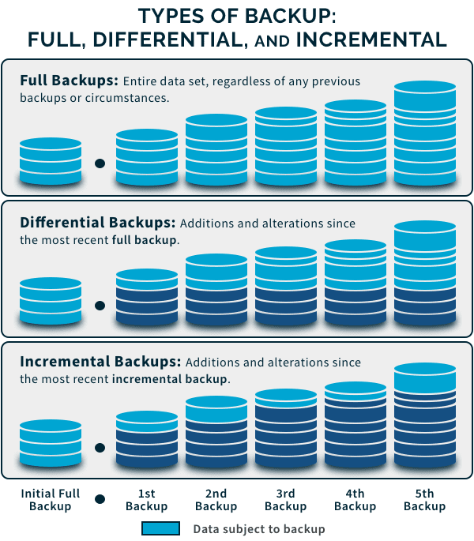
Source: https://www.spanning.com/blog/types-of-backup-understanding-full-differential-incremental-backup/

Slide 31
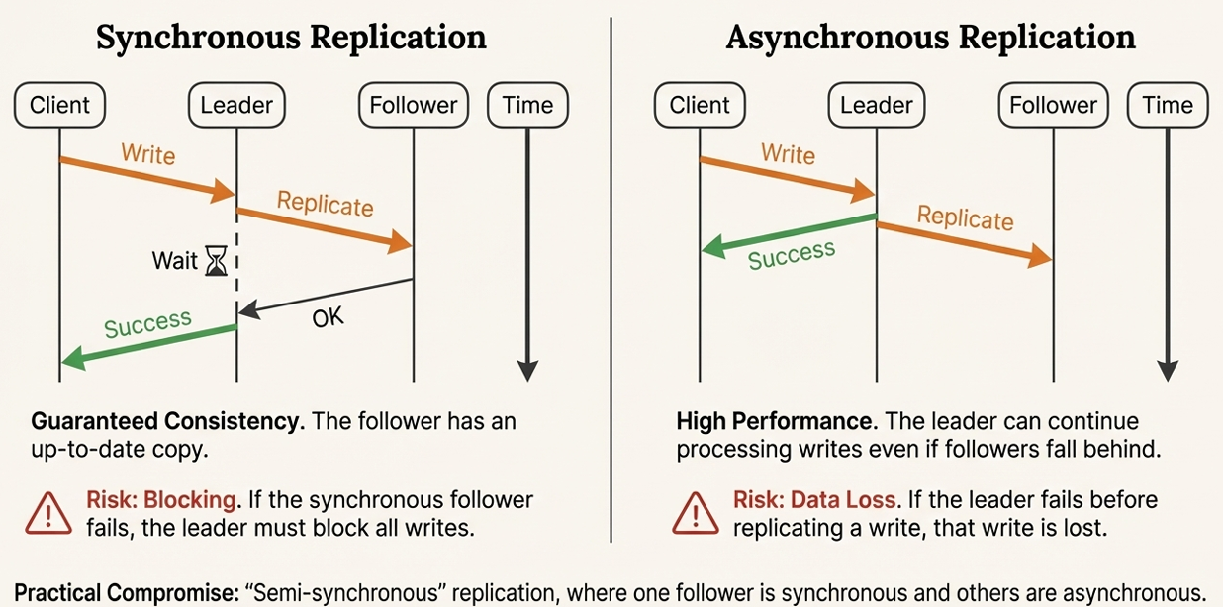
Replication Types
 | Synchronous | Asynchronous
How it works | Data is written to primary and replica at the same time; transaction completes only after both succeed. | Primary writes first, then sends data to replica with a delay.
Recovery Speed | Fastest; almost immediate failover. | Fast, but with slight lag.
RPO Impact | Near-zero data loss. | Some data loss possible (seconds to minutes).
Example | Banking systems requiring no transaction loss. | DR site updated every few seconds for a retail system.

Slide 32
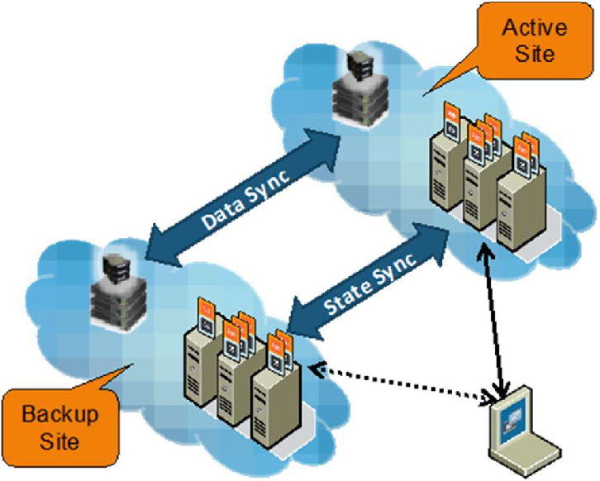
Disaster Recovery Center
A Disaster Recovery Center (also called an alternate processing site or recovery site) is the physical facility an organization moves its operations to when its primary site becomes unavailable because of a disaster.
It's the practical, physical backbone of a Disaster Recovery Plan (DRP), the "where" that all the recovery procedures point to

Slide 33
Alternate Sites
Alternate Site Type | What It Provides | Recovery Time | Cost | Key Characteristics | Example
Cold Site | Empty facility with power and basic environment; no equipment installed. | Days to weeks. | Low. | Requires bringing hardware, installing systems, restoring data. | Government office with rental space reserved for emergencies.
Warm Site | Partially equipped site with hardware and connectivity, but requires setup and data restoration. | Hours to days. | Moderate. | Some configuration needed after activation. | Insurance company with pre-installed servers but no live data.
Hot Site | Fully equipped facility with hardware, network, near-real-time data. | Hours or less. | High. | Ready to operate immediately; supports critical systems. | Financial institution failover center.
Mirrored Site | Fully redundant, with real-time data replication from production site; fully staffed and equipped | Near-zero. | Very High. | Real-time replication; identical hardware and software. | A stock exchange or global payment processor

Slide 34
Auditor Responsibilities
#goingWell

Slide 35
What the IS Auditor Must Evaluate
IS auditors must verify that:
BIA is performed correctly
Recovery metrics are realistic and approved
Controls exist for continuity and recovery
Plans are documented, updated, and tested
Backup procedures are well-designed and monitored
Roles & responsibilities are clear
Alternate sites and service providers can meet requirements

Slide 36
What Auditors Check
BIA completeness
Critical processes identified
RTO, RPO, WRT, MTD are defined and realistic
Continuity & recovery plans
BCP, DRP, ITSC plans documented
Roles and responsibilities assigned
Technical controls
Backups (process, frequency, integrity checks)
Redundancy, failover, alternate sites
Testing & maintenance
Regular tests performed (tabletop → full test)
Issues tracked and improvements implemented
Alignment & governance
Plans match business priorities
Senior management approval and oversight

Slide 37
Quiz
Via jurnal

